Slide 1

servers
Notes:
Quick intro to serverless
Maturity model
Wardley map, discussion on utilities
Benefits / ideas about how this changes everything
Adoption ideas
Focus on high value changes
Challenges to implement
Experiences at GameStop

Slide 2



Slide 3
Your business doesn’t have technology problems

Slide 4


Slide 5


Slide 6
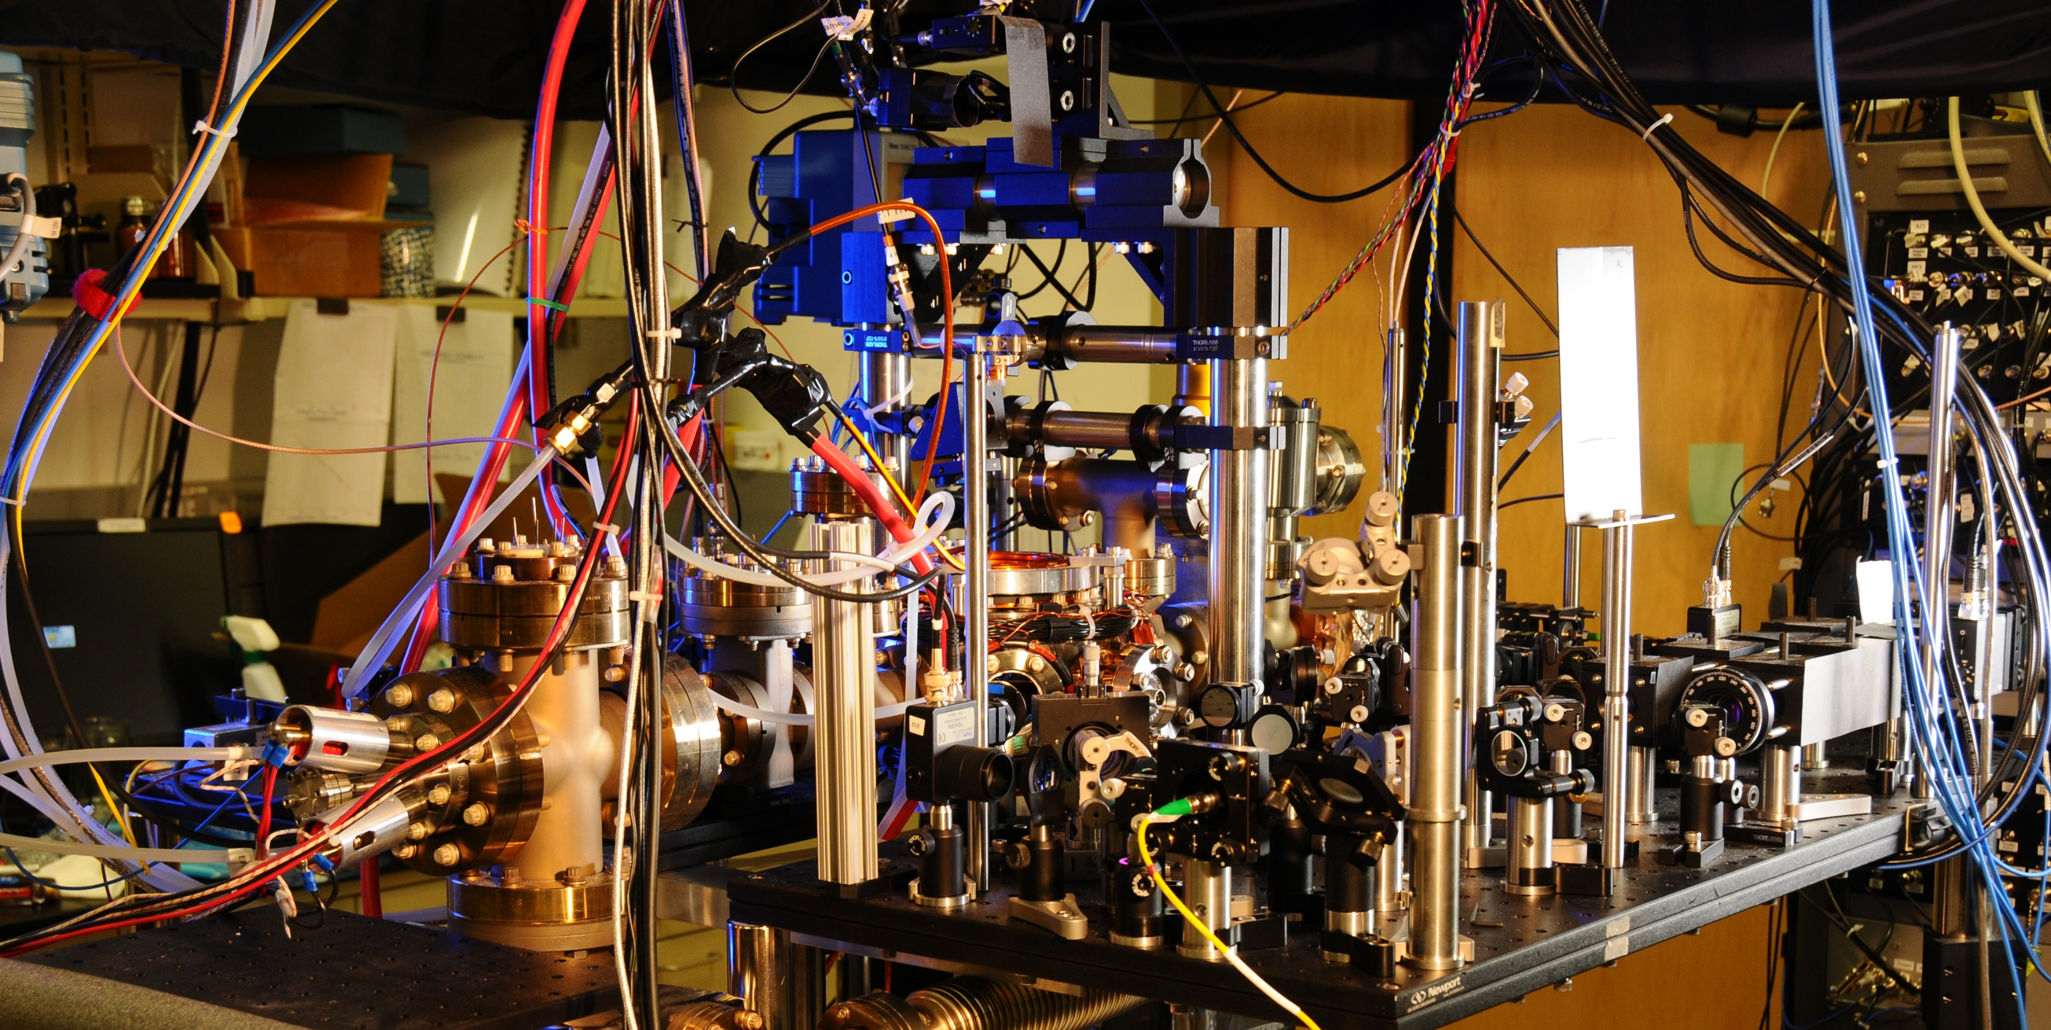
Notes:
Spanner ( Google’s modern relational database management systems that seek to provide the same scalable performance of NoSQL systems for online transaction processing (OLTP) read-write workloads while still maintaining the ACID guarantees of a traditional database system.^{[)1][2][3])}

Slide 7
You still have problems
Notes:
Staying relevant (MySpace) - Facebook
Scaling globally (?)
Reaching new demographics (Netflix launches to 60 countries)
Avoiding political pitfalls
Creating new products/services
Staying price competitive
Adapting to change (Blockbuster)

Slide 8


Slide 9


Slide 10


Slide 11
You don’t have technology problems
Solving technology problems isn’t your business

Slide 12





20 - 40%
40 - 60%
60 - 80%

Slide 13
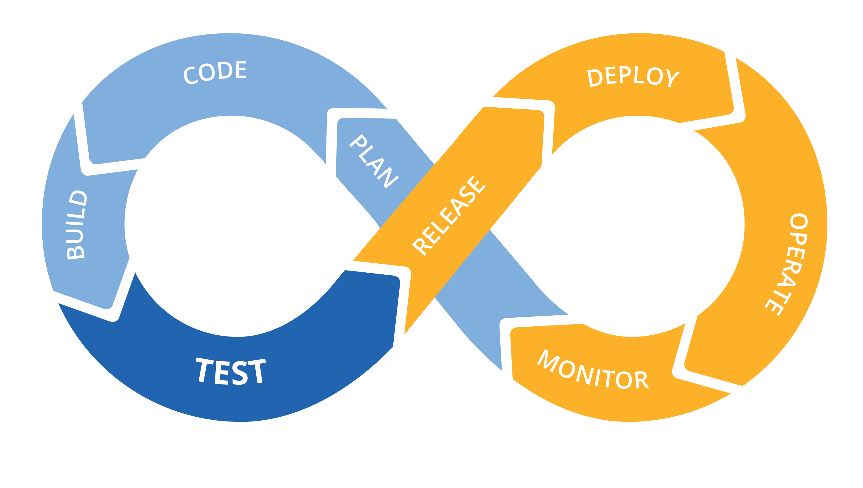
We have nothing new to offer
Notes:
Infrastructure as code
CI/CD for increased speed and stability
Monoliths to microservices to functions
Small teams, highly cohesive and loosely coupled
Only pay for what you use
Polyglot – the right language/framework for the job

Slide 14
Energy
 | Time
Activation energy

Slide 15
Time spent on technology problems
 | Time
Difficulty of the change
Time required for change

Slide 16
Time spent on technology problems
 | Time
Catalysts change the equation

Slide 17
Time spent on technology problems
 | Time
Serverless changes the equation
Catalysts change the equation

Slide 18


f(n) + +

Slide 19

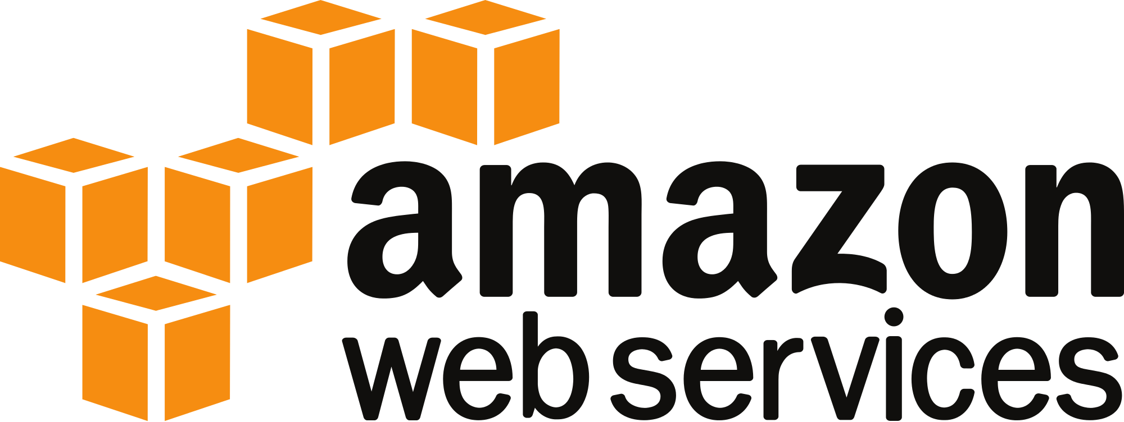
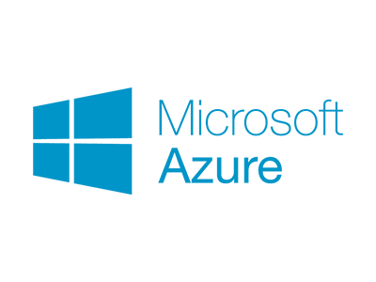


f(n) + +

Slide 20



Now for some predictions
Notes:
True variable cost computing
Time to market goes from months or weeks to days or hours
Built in support for things you should be doing already
Infrastructure as code
API driven development and data analysis to inform product development
Small teams
It’s like magic – haven’t met a developer who didn’t love it
Easy to use, easy to experiment with
Low cost to learn, develop with, experiment with – only cost is time, no infrastructure or hosting
Starts a chain reaction across your organization

Slide 21


Slide 22


Slide 23

Data driven decision making

Slide 24

Small, product focused teams

Slide 25

Cloud adoption & automation

Slide 26

Discovery through experimentation
Notes:
If relying on large efforts to change the organization and add business value, putting all your eggs in a single basket
Implies being able to clearly see the end from the beginning
Huge opportunity cost
Feel your way along and change to what’s working better

Slide 27


Unique value proposition to DevOps laggards
Notes:
Everyone, but the value will you get is inversely related to the investments you have made in DevOps and the cloud already
For mature DevOps and cloud companies the benefits will be more incremental because they are already following best practices
For companies without strong DevOps or cloud practices the value is much higher

Slide 28
(Not so) Bold Predictions

Slide 29
You can do it with the people you have now

Slide 30
You can start today (there will be a framework for that)

Slide 31
Enterprise-grade tools are right around the corner

Slide 32
Environments as Cattle

Slide 33
No More “IT Lever Pullers”

Slide 34
Faster Time-to-Market

Slide 35
Slightly Bolder Predictions

Slide 36
Invalidate the Mythical Man Month

Slide 37
IT Governance, Security & Ops as a constant cost…

Slide 38
…all while your IT ecosystems becomes more diverse

Slide 39
Customer-centric IT purchase model? Table-stakes

Slide 40
Decline of the IT PMO

Slide 41
Software & Services Assemble themselves (serverless + usage data + ML)

Slide 42




Notes:
If the people you’ve hired have built a mature DevOps and cloud company they already know about serverless and love it, and probably are already using it
If the people you’ve hired haven’t built a mature DevOps and cloud company
If they would like to but can’t for whatever reasons, they likely know about serverless and have used it on side projects and love it
If they aren’t pushing for DevOps or cloud there’s a good chance they don’t know anything about serverless (or DevOps practices in general)
Know the group you are working with

Slide 43







Where it’s already started

